Slide 1
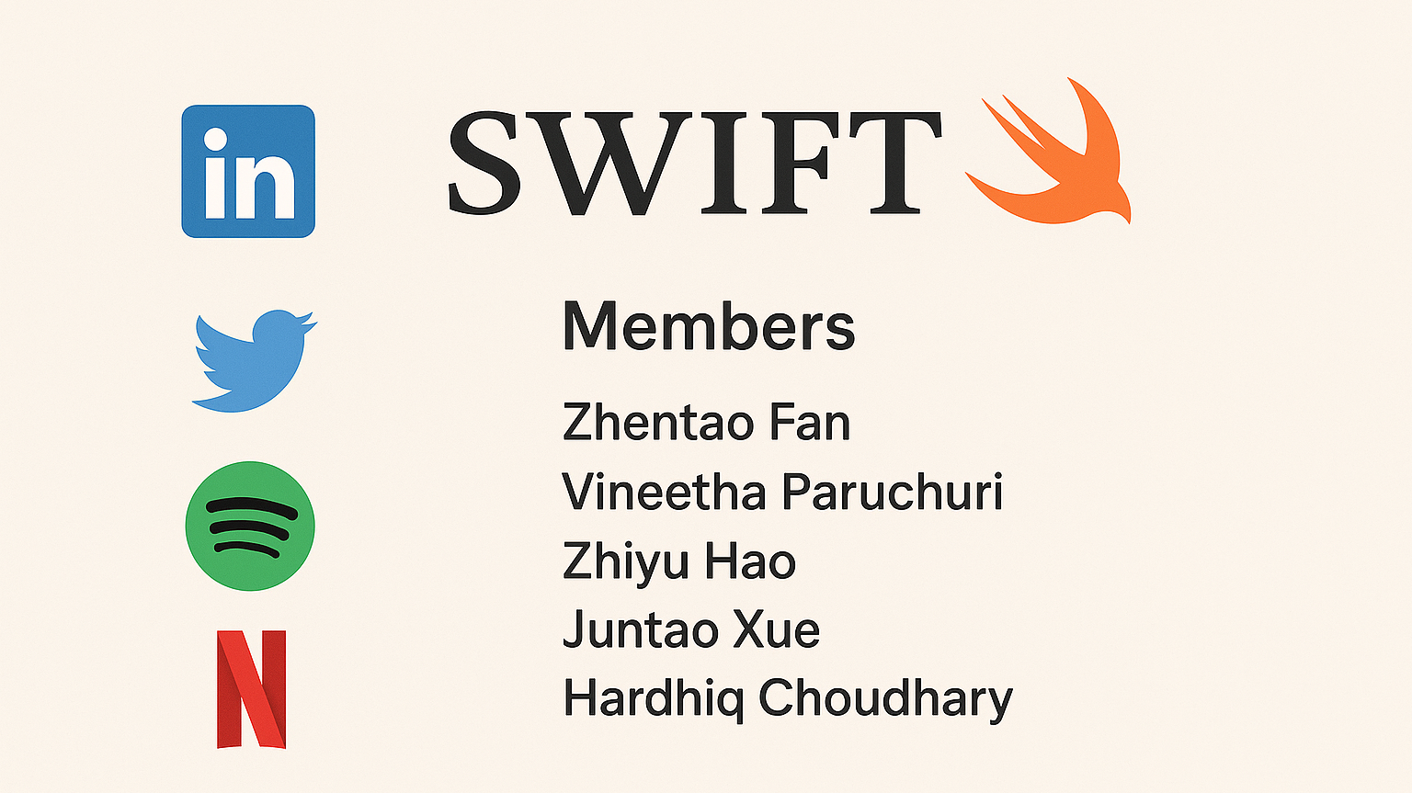

Slide 2
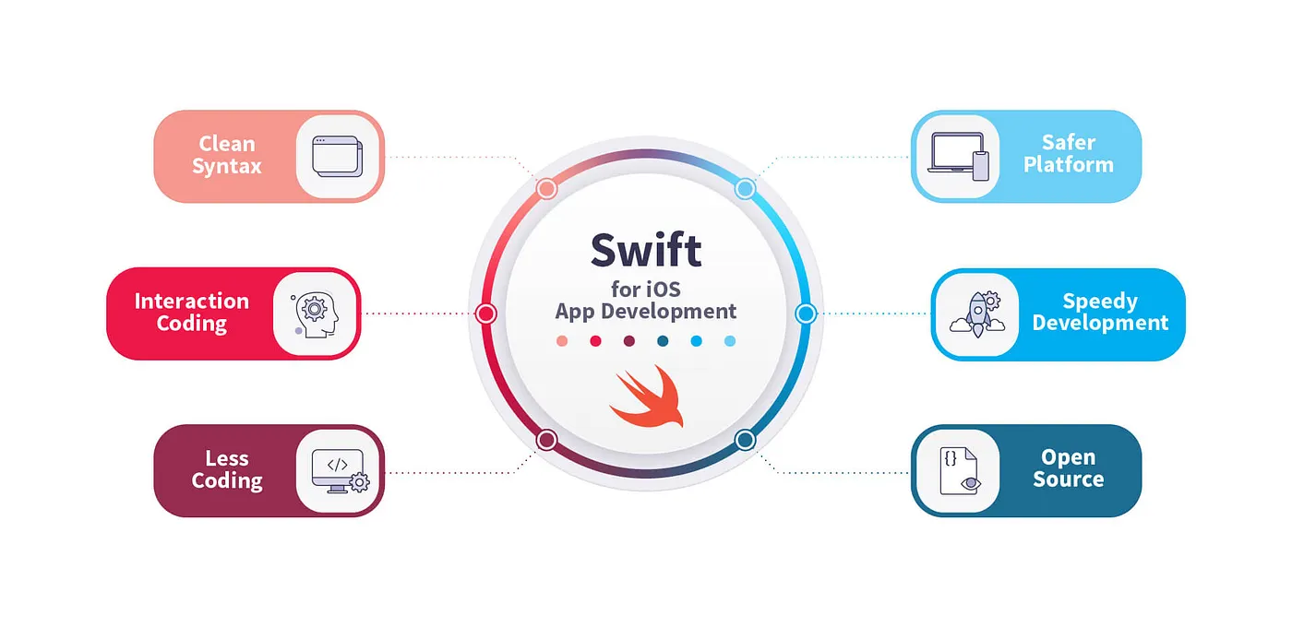
Swift is a powerful and intuitive programming language for iOS, iPadOS, macOS, tvOS, and watchOS. Writing Swift code is interactive and fun, with a concise yet expressive syntax and modern features like type inference, optionals, and closures. Swift ensures code safety and high performance. Many popular apps, including LinkedIn, YouTube, and Netflix, use Swift in parts of their iOS development to improve performance, maintainability, and development efficiency.
Source : Apple Developer – Swift , Swift.org - About Swift

Slide 3
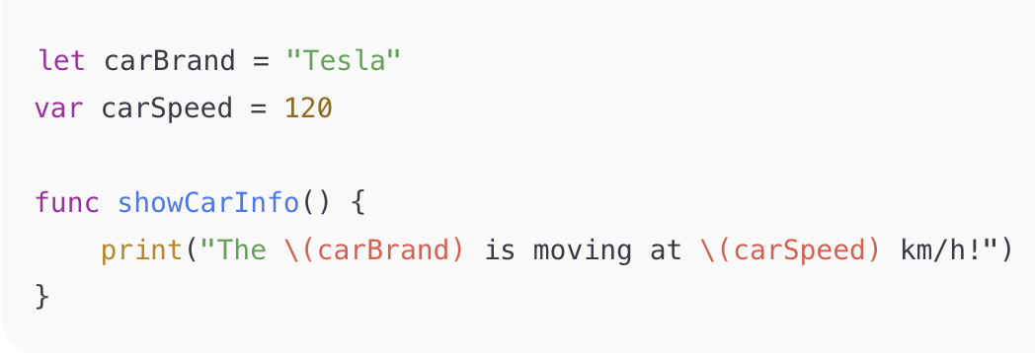
Names A name (identifier) in Swift is a symbolic label used to refer to variables, constants, functions, types, and other entities.
Naming Rules :
Names can contain letters, digits, and underscores but cannot start with a digit.
They are case-sensitive (Score ≠ score).
Reserved keywords like let, var, func, etc., cannot be used as names unless backticked (`let`). Here, carBrand, carSpeed, and showCarInfo are names bound to a constant, variable, and function.
Source : Apple Swift Language Guide – Identifiers

Slide 4
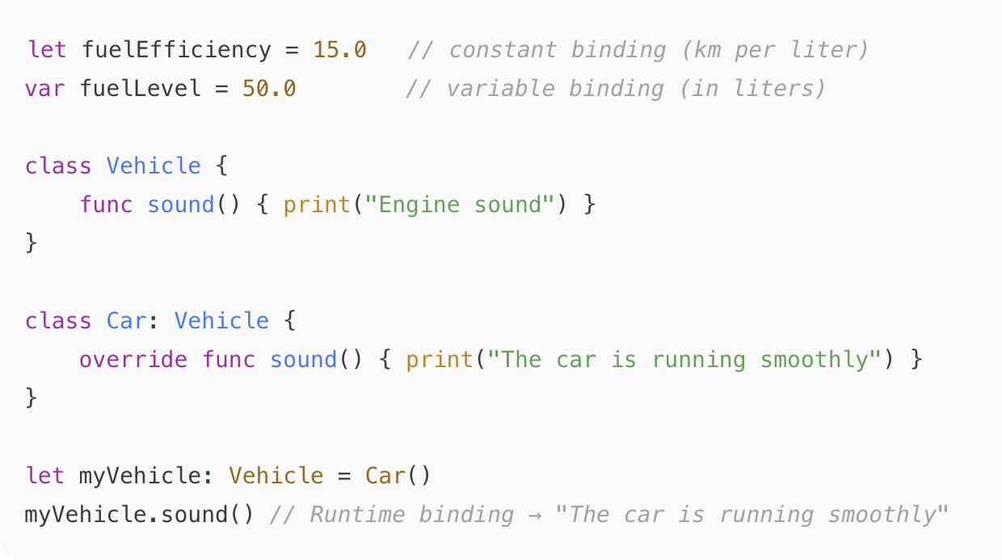
Binding Binding means connecting a name with a value or function. Swift mostly uses static (compile-time) binding but allows dynamic (runtime) binding for class methods. Types:
let → constant binding (immutable)
var → variable binding (mutable)
Class inheritance → dynamic method binding.
Source : Swift Functions , Inheritance

Slide 5
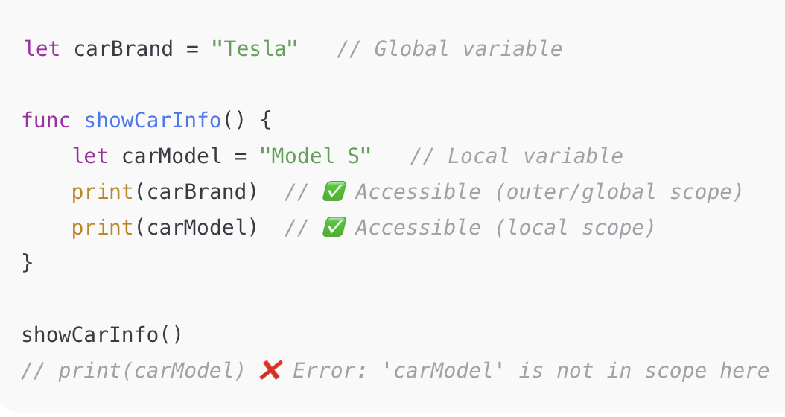
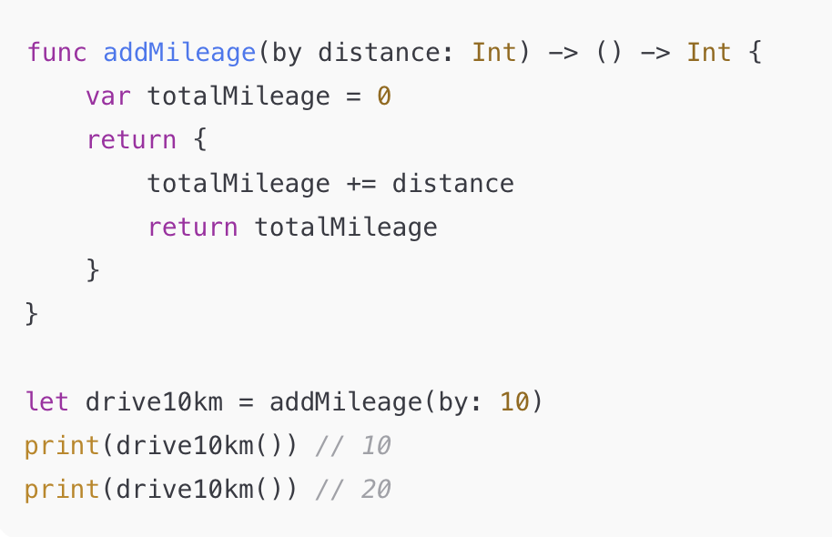
Scopes
Scope defines where a name is visible in code. Swift uses lexical (static) scoping, determined by code structure.
Types:
Global → visible everywhere in the module
Local → within a function/block
Nested → inner scopes can access outer variables Inner functions can “capture” outer variables (closure capture), allowing persistence even after the outer function ends.
Closures Example :
Source : Closures

Slide 6
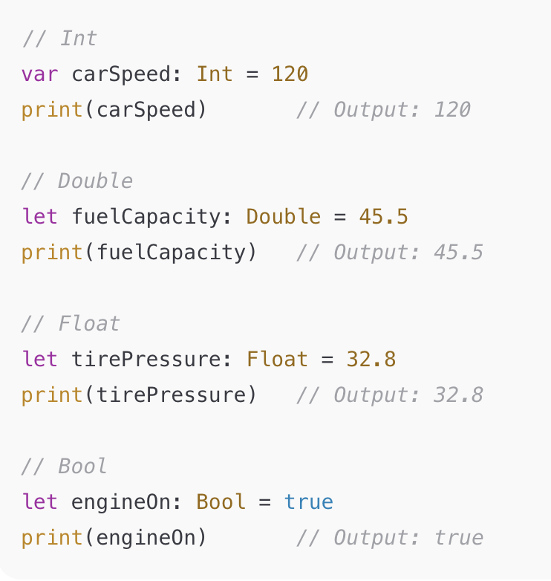
Data Types
A data type defines the kind of value a variable or constant can hold. Swift is a strongly typed language, meaning every value has a type, and type safety is enforced at compile time. Types help prevent errors and make code more predictable. Type Description Int Integers Numbers Double Floating-Point Numbers Float 32-bit Floating Point Bool Boolean (True/False)
Source : The Basic Types

Slide 7
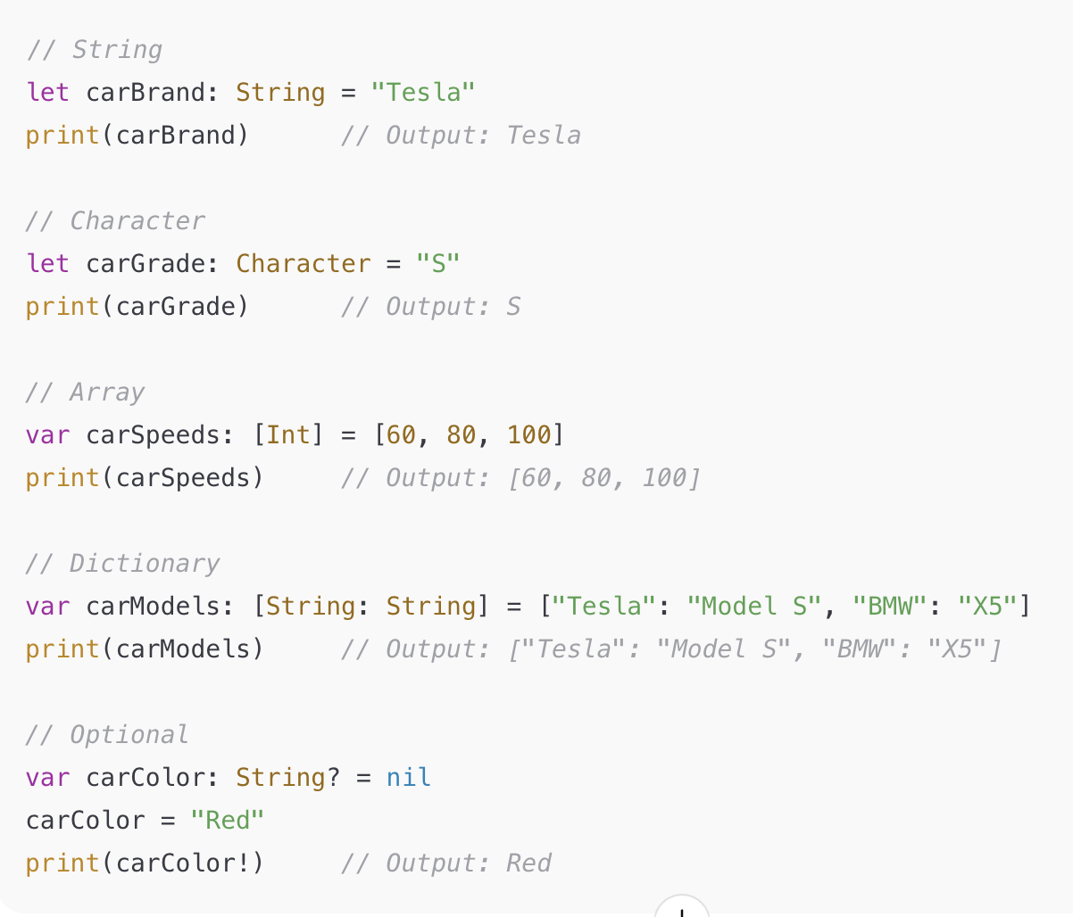
Data Types
Type Description String Text Character Single Character Array Ordered Collection Dictionary Key-Value Pairs Optional Value may be NIL
Source : Strings and Characters , Optionals

Slide 8
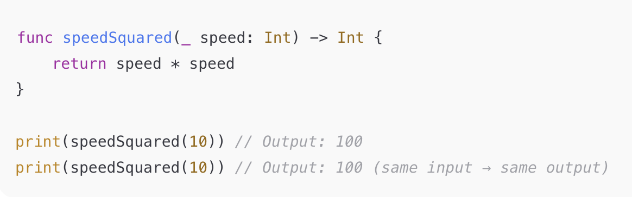
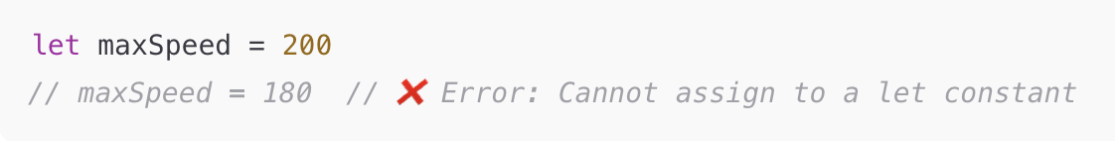
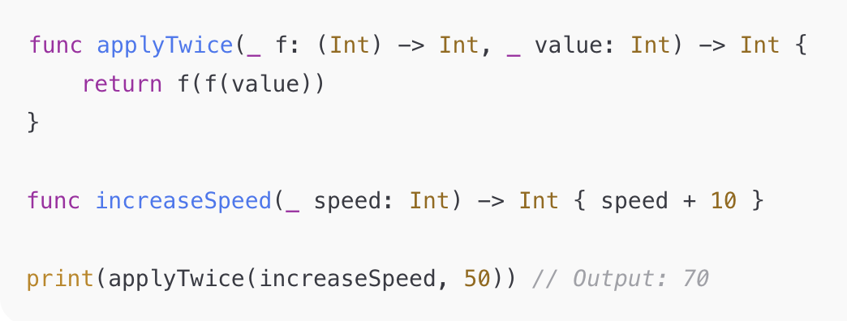
Pure Functions
Functional Programming
Functional programming (FP) is a programming paradigm where computation is done through pure functions, immutable data, and function composition, rather than changing state or using loops. Swift supports functional programming concepts alongside object-oriented programming.
Key Concepts in Swift Functional Programming : Pure Functions : Functions that always return the same output for the same input and have no side effects.
Immutable Data : Use let constants instead of var to prevent changing state. Higher-Order Functions : Functions that take other functions as arguments or return functions.
Immutable Data
Higher-Order Functions
Source : Functions , Immutable

Slide 9
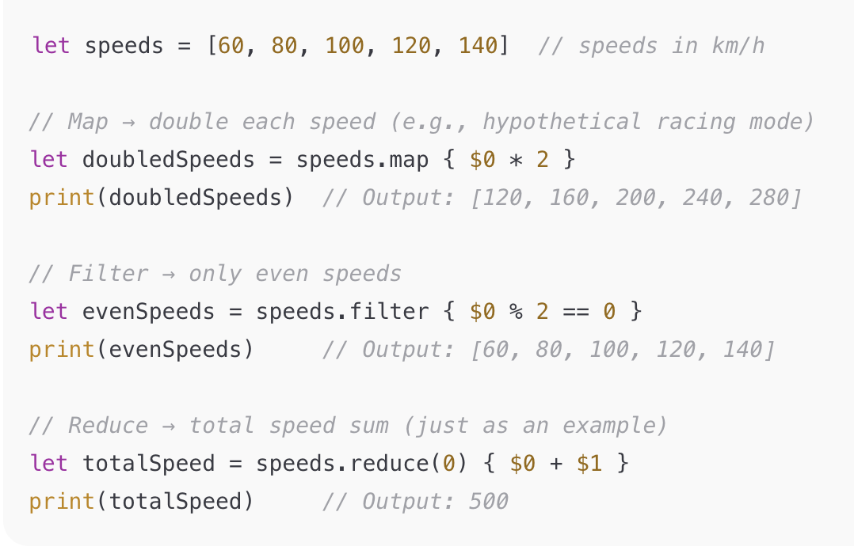
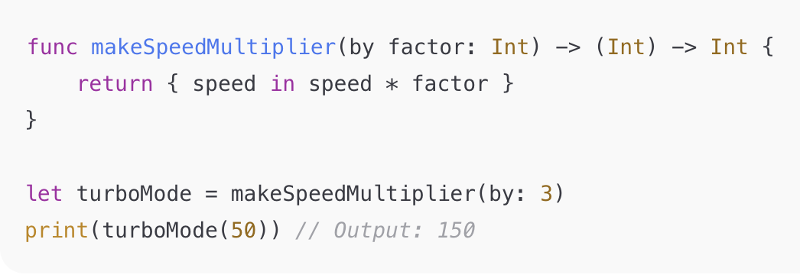
Map, Filter, Reduce
Functional Programming
Key Concepts in Swift Functional Programming : Map, Filter, Reduce : Functional operations for transforming or aggregating collections.
Closures : Anonymous functions that can capture values from their surrounding context.
Closure
Source : Map-Filter-Reduce , Closures

Slide 10
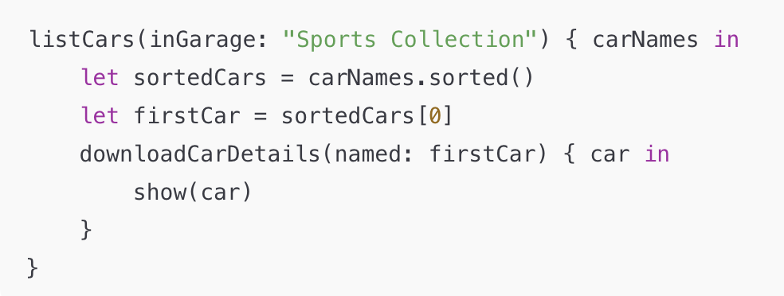
Concurrency
Concurrency means doing multiple tasks at the same time, without waiting for one to finish before starting another. Swift provides built-in support for writing asynchronous and parallel code.
Asynchronous code can suspend and resume execution, allowing other tasks to run while waiting for long-running operations like network requests.
Parallel code runs multiple pieces of code at the same time, e.g., on a multi-core processor.
Combining asynchronous and parallel execution is referred to as concurrency.
Source : Concurrency

Slide 11
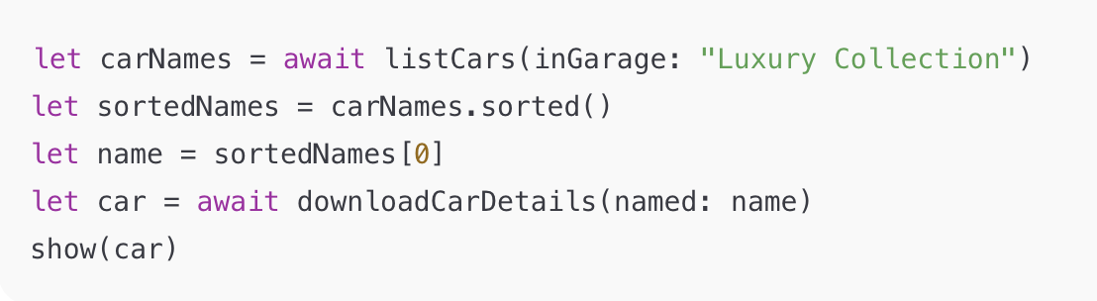
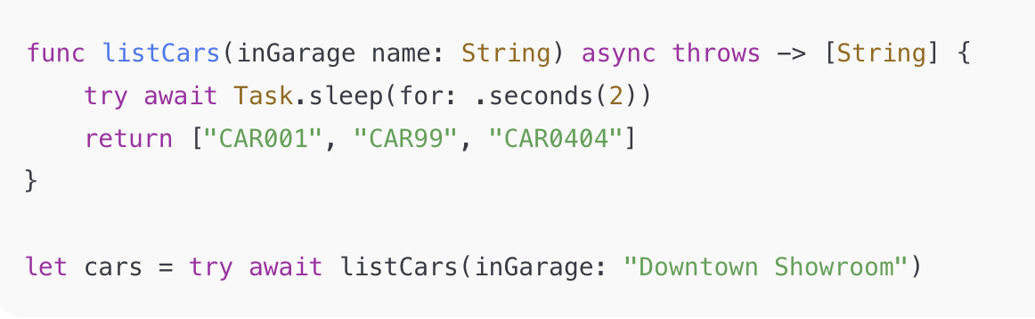
Concurrency
Defining and Calling Asynchronous Functions : Asynchronous functions pause execution at suspension points and resume later.
Use “async” to declare a function asynchronous and “await” to mark suspension points.
Asynchronous functions that can throw use both async and throws:
The throws keyword means that the function can produce an error during execution.
Source : Concurrency

Slide 12
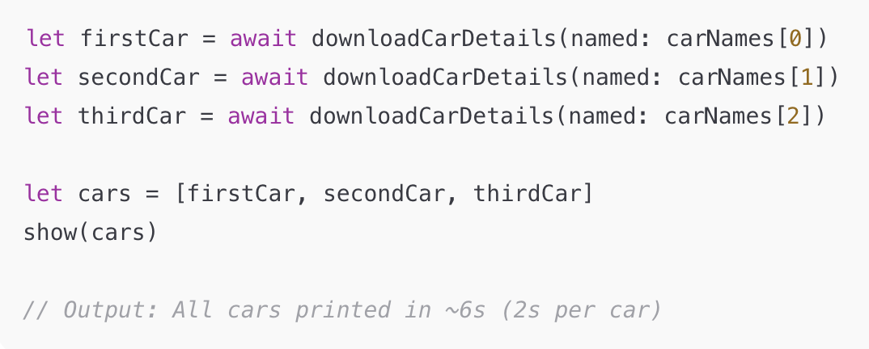
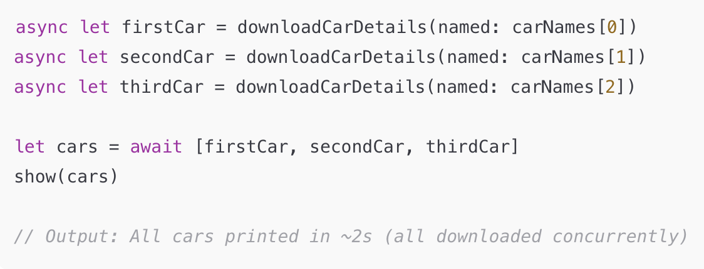
Parallel Asynchronous Calls
Concurrency
Parallel Asynchronous Calls : Using “await” sequentially runs one call at a time. Using “async let” runs multiple calls in parallel.
Source : Concurrency

Slide 13
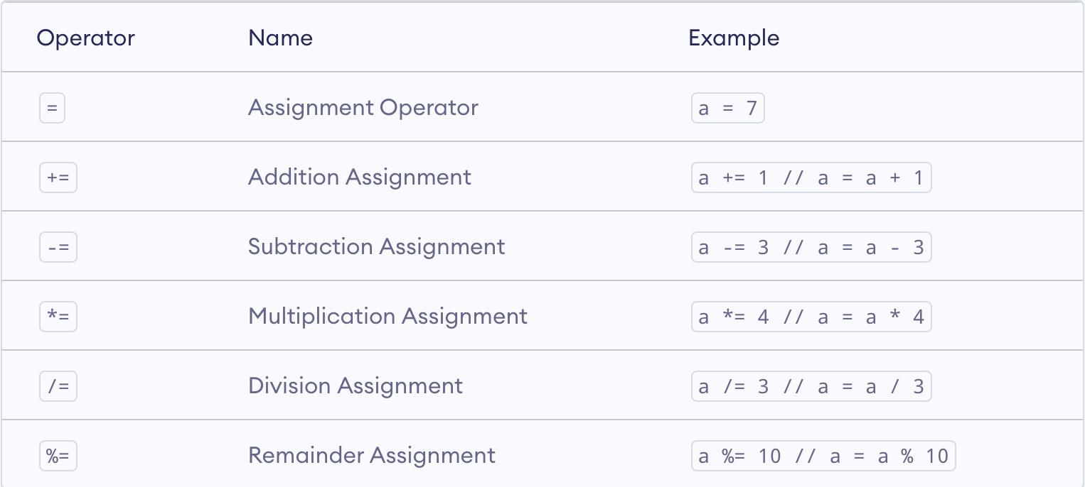
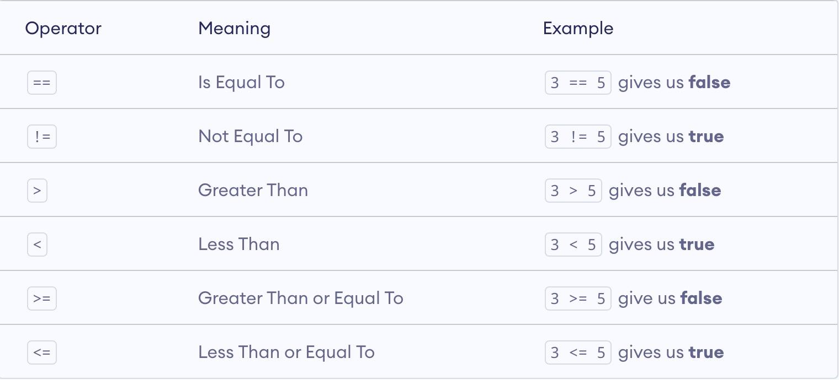
Assignment Operator
Operator in Swift
In Swift, operators are special symbols or phrases used to check, combine, and change values.
Assignment operator: Used to assign or update variable values.
Comparison Operator
Comparison operator: Used to compare two values — result is “true” or “false”.
Source : Closures

Slide 14
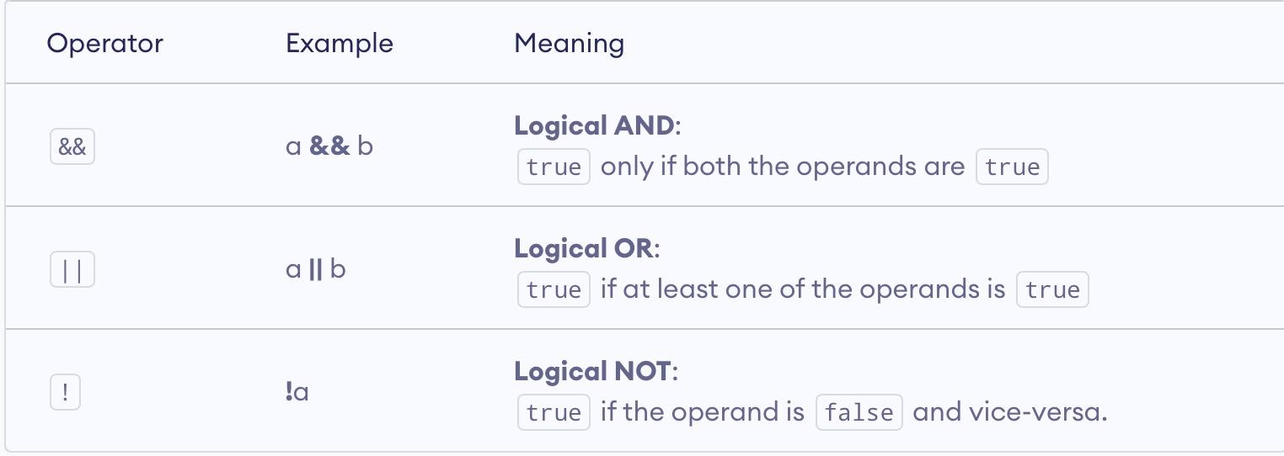
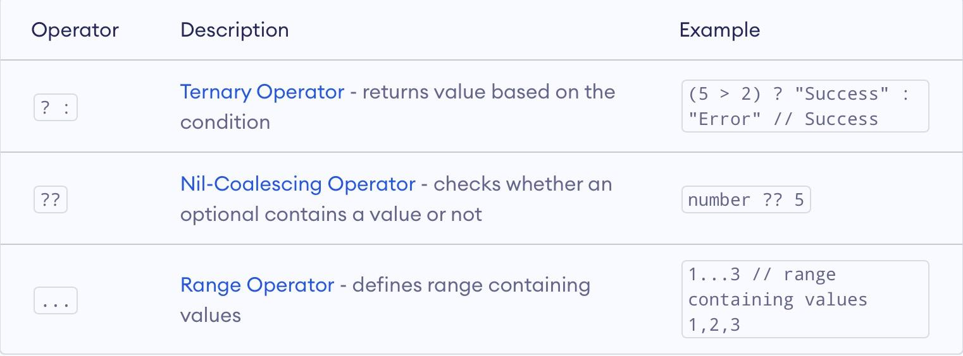
Logical Operator
Operator in Swift
Logical Operator : Used to combine or invert Boolean values.
Special Operator
Special Operator : Used for conditional and optional handling.
Source : Closures

Slide 15
Precedence in Swift
Precedence group | Common operators | Associativity | Notes
Postfix | (), [], ., ?, !, postfix ++, --(removed) | none | function call, member access, optional-chaining, force unwrap
Prefix | unary -, +, !, ~, &, prefix ++, --(removed) | right | negation, logical NOT, address-of
Multiplication Precedence | *, /, % | left | numeric multiply/divide/mod
Addition Precedence | +, - | left | addition, subtraction
Range Formation Precedence | ..., ..< | none | closed / half-open ranges
Casting Precedence | is, as, as?, as! | none | type checks and casts
Nil Coalescing Precedence | ?? | right | nil-coalescing
Comparison Precedence | <, <=, >, >=, ==, !=, ===, !==, pattern-match ~= | none | comparisons and matching
Logical Conjunction Precedence | && | left | logical AND
Ternary Precedence | ?: | right | ternary conditional
Assignment Precedence | =, *=, /=, +=, -=, %=, <<=, >>=, &=, ` | =, ^=` | right
Source : Closures

Slide 16
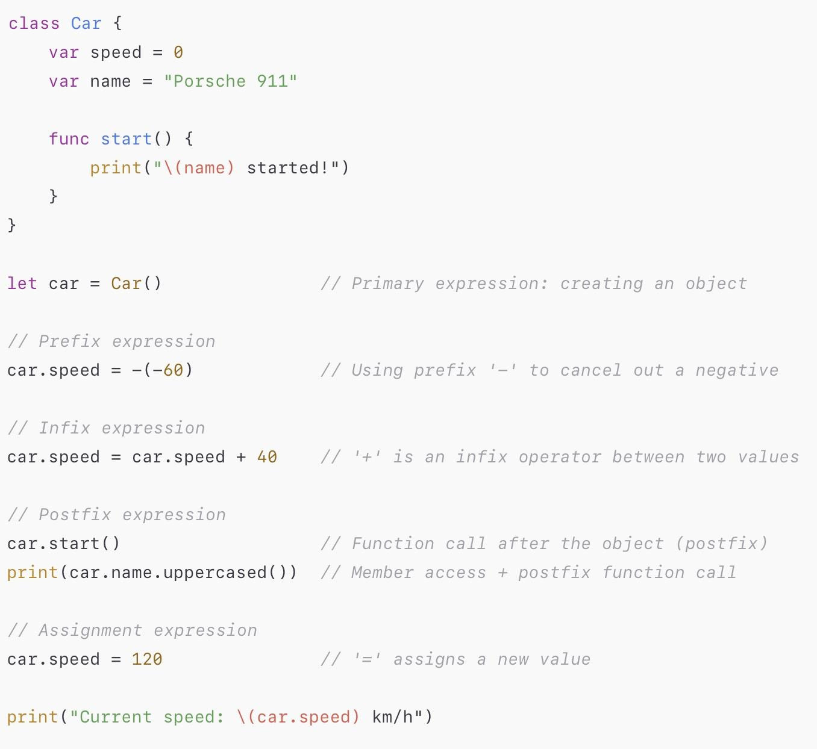
Expression and Assignment Statements
In Swift, an expression is a piece of code that produces a value, performs an action, or both. There are four kinds of expressions: primary, prefix, infix, and postfix. Primary expressions: directly access values like constants or literals.
Prefix expressions: place an operator before a value, such as -a or !flag.
Infix expressions: place an operator between two values, such as a + b or x > y.
Postfix expressions: place an operator or notation after a value, such as array.count
Source : Closures

Slide 17
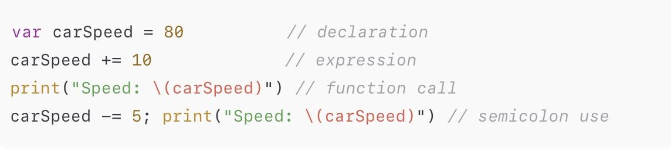
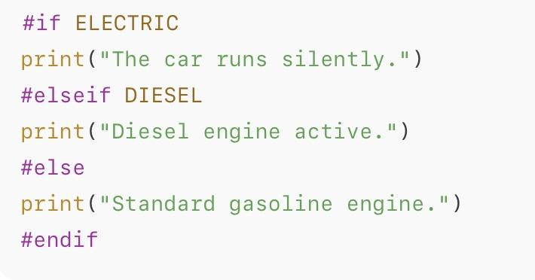
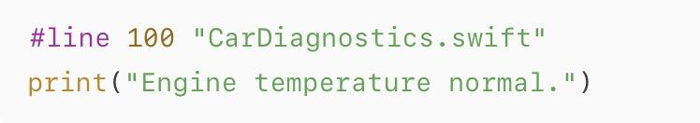
Simple statement and compiler control statement
Simple Statements:
Can be an expression (e.g., function call, assignment) or a declaration (e.g., defining a variable or constant).
Ended optionally by a semicolon ; — only required if multiple statements appear on the same line.
Compiler Control Statements
Change how the compiler interprets or processes parts of the code.
Include: #if, #elseif, #else, #endif — conditional compilation; #line — line control statement for custom line numbers or file names.
Source : Closures

Slide 18
Control-flow Statements in Swift
Type | Purpose | Examples
Loop statements | Repeat a block of code | for, while, repeat-while
Branch statements | Choose a path based on a condition | if, guard, switch
Control transfer statements | Change the normal flow | break, continue, return, throw, fallthrough
Do statement | Create a new scope and handle errors with do-catch | do { try ... } catch { ... }
Defer statement | Schedule code to run before leaving the current scope | defer { cleanup() }
Source : Closures

Slide 19
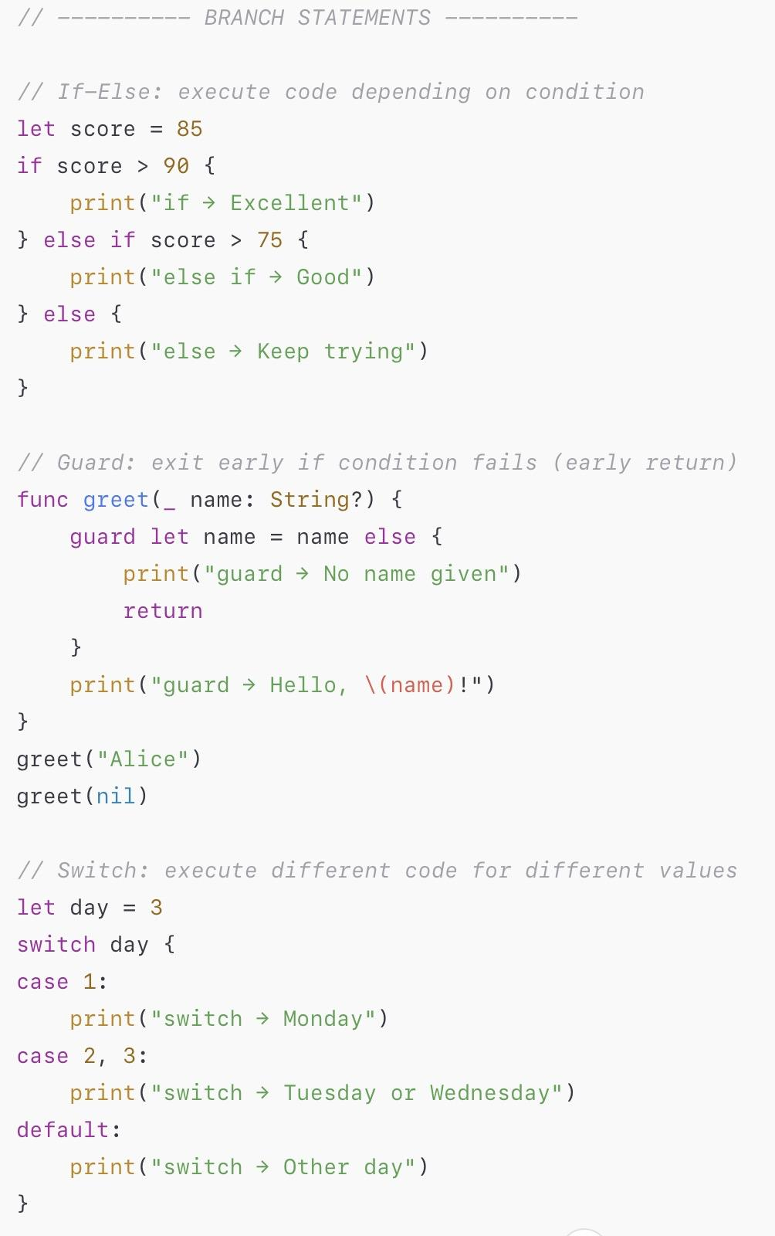
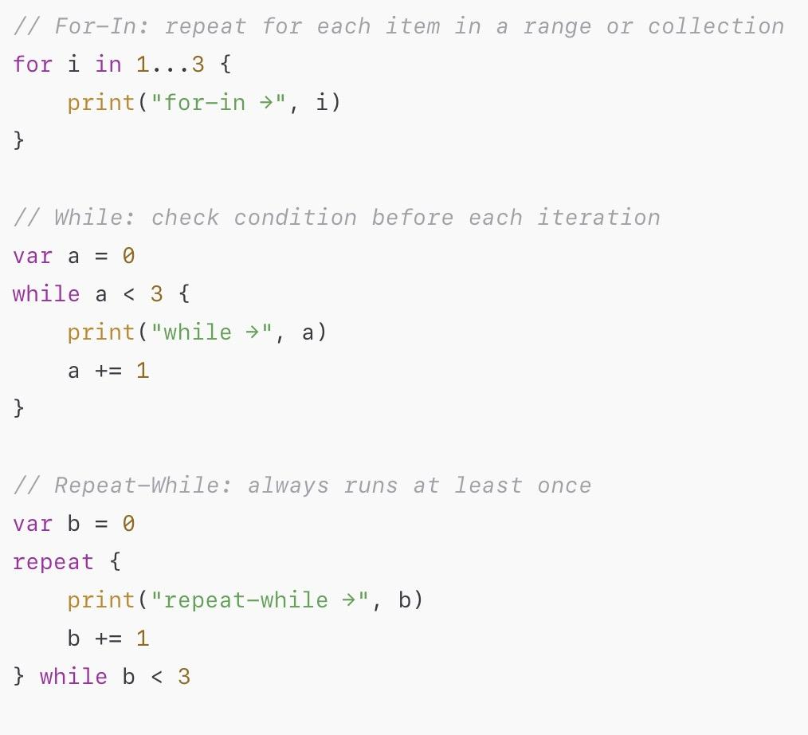
Loop statement and Branch statement
Source : Closures

Slide 20
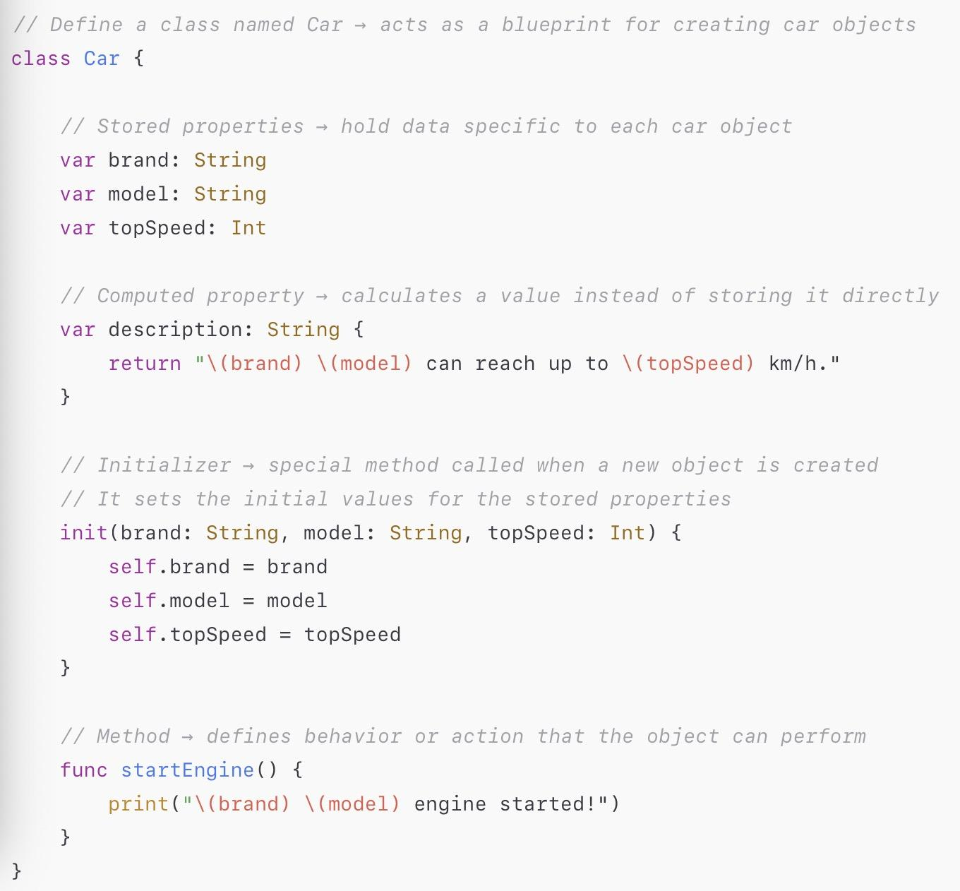
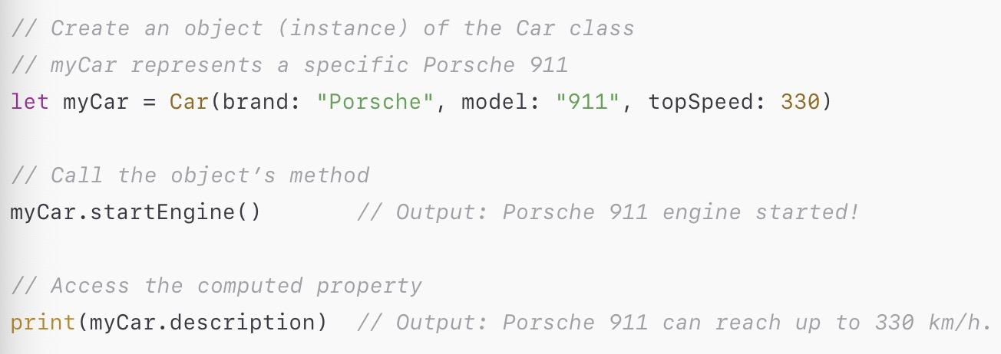
Class and Objects
A ”Class” is a blueprint for creating objects that share common properties and behaviors. It defines what data (called properties) and actions (called methods) an object can have.
An ”Object” is a specific instance of a class — it represents one real example created from that blueprint. Each object has its own copy of the class’s properties and can use its methods to perform actions.
Properties : variables or constants that store values for each object of the class.
Methods : functions that provide functionality for the objects of the class.
Initializers : special methods that are called when an object of the class is created. Initializers can set initial values for the properties or perform other tasks.
Source : Closures

Slide 21
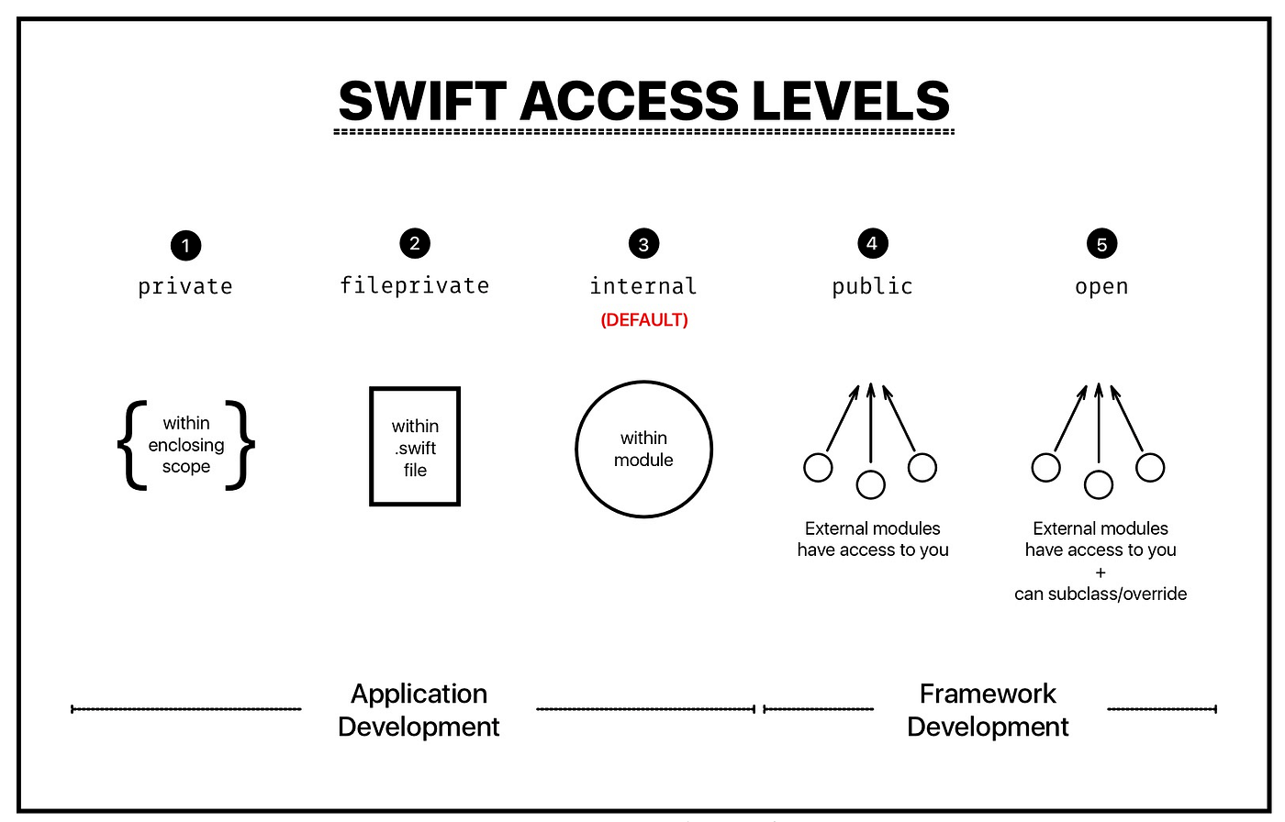
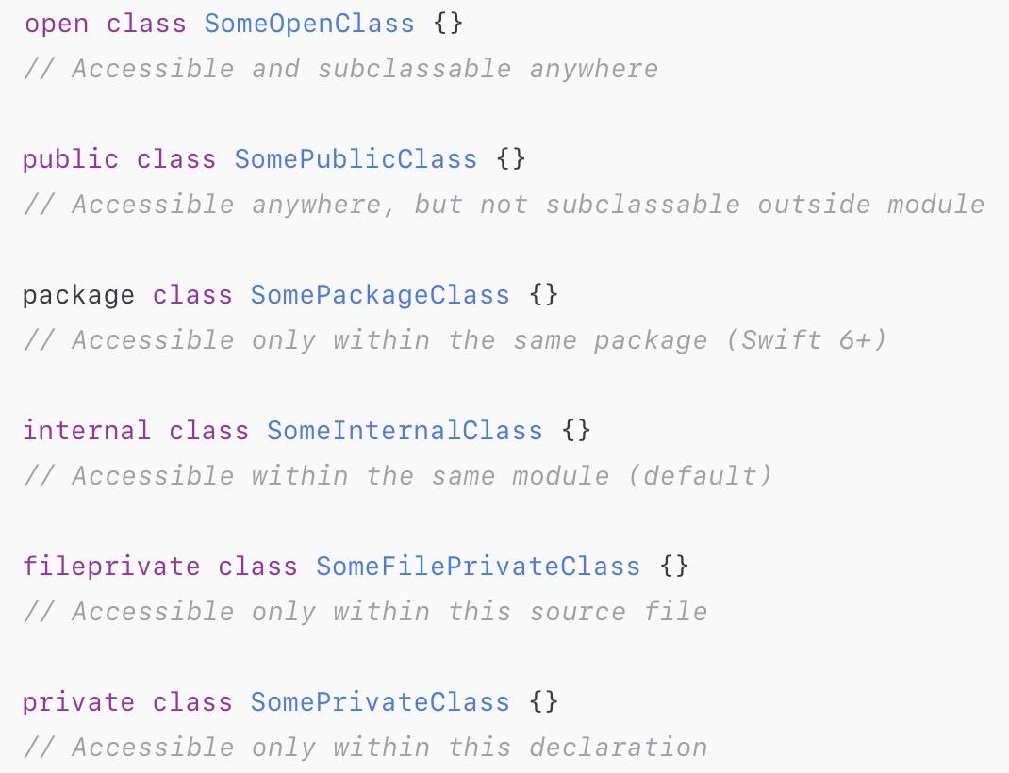
Encapsulation
Open :
Can be used inside or outside the defining module.
Allows subclassing and method overriding in other modules.
Applies only to classes and class members.
Public :
Can be accessed from any module that imports this one.
Visible everywhere but not extendable outside the module.
Package (New in Swift 5.9) :
Accessible within the same package, across multiple modules.
Not visible outside the package.
Internal :
Accessible anywhere within the same module, but not from another module.
File-private :
Visible only inside the same source file. Use to hide helper code that supports multiple types in one file.
Private :
Accessible only inside the same declaration (class/struct/extension). Use for strict data hiding
Source : Closures

Slide 22
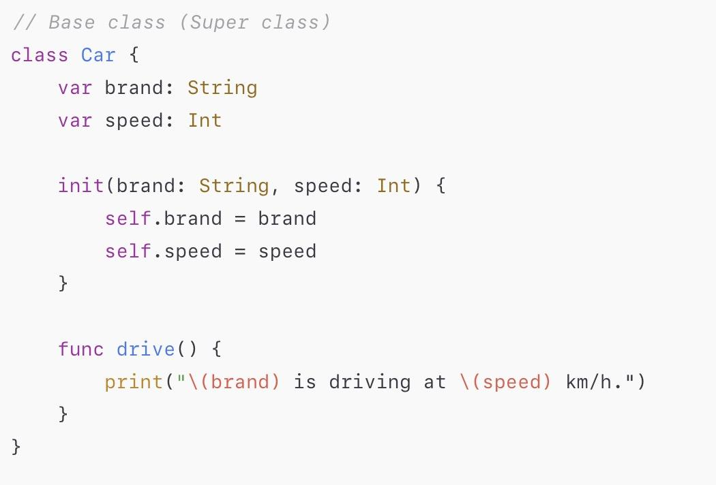
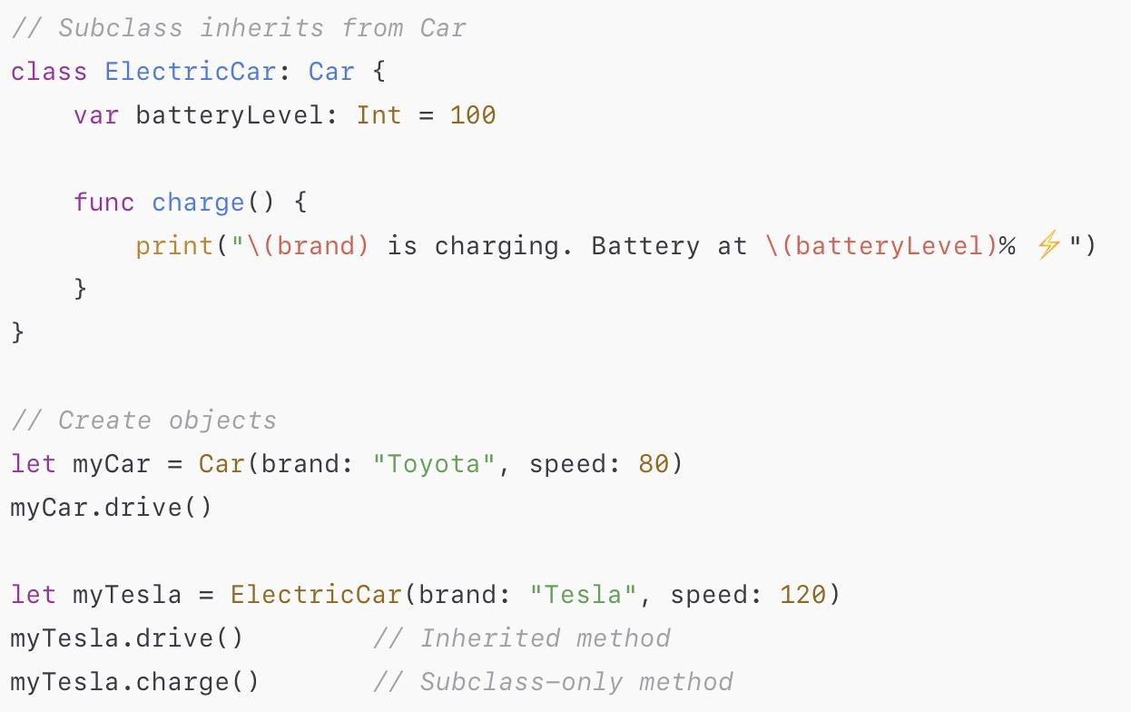
Inheritance
Inheritance : A class can inherit methods, properties, and other characteristics from another class.
Base class : is any class that does not inherit from another class.
Subclassing means creating a new class from an existing one. The inheriting class is called a subclass.
The class it inherits from is called the superclass (or parent class).
Swift only support single inheritance
A subclass can call and access its superclass’s methods, properties, and subscripts.
The superclass provides the base functionality, and the subclass can extend or override it.
Super: Access superclass’s original implementation.
Source : Closures

Slide 23
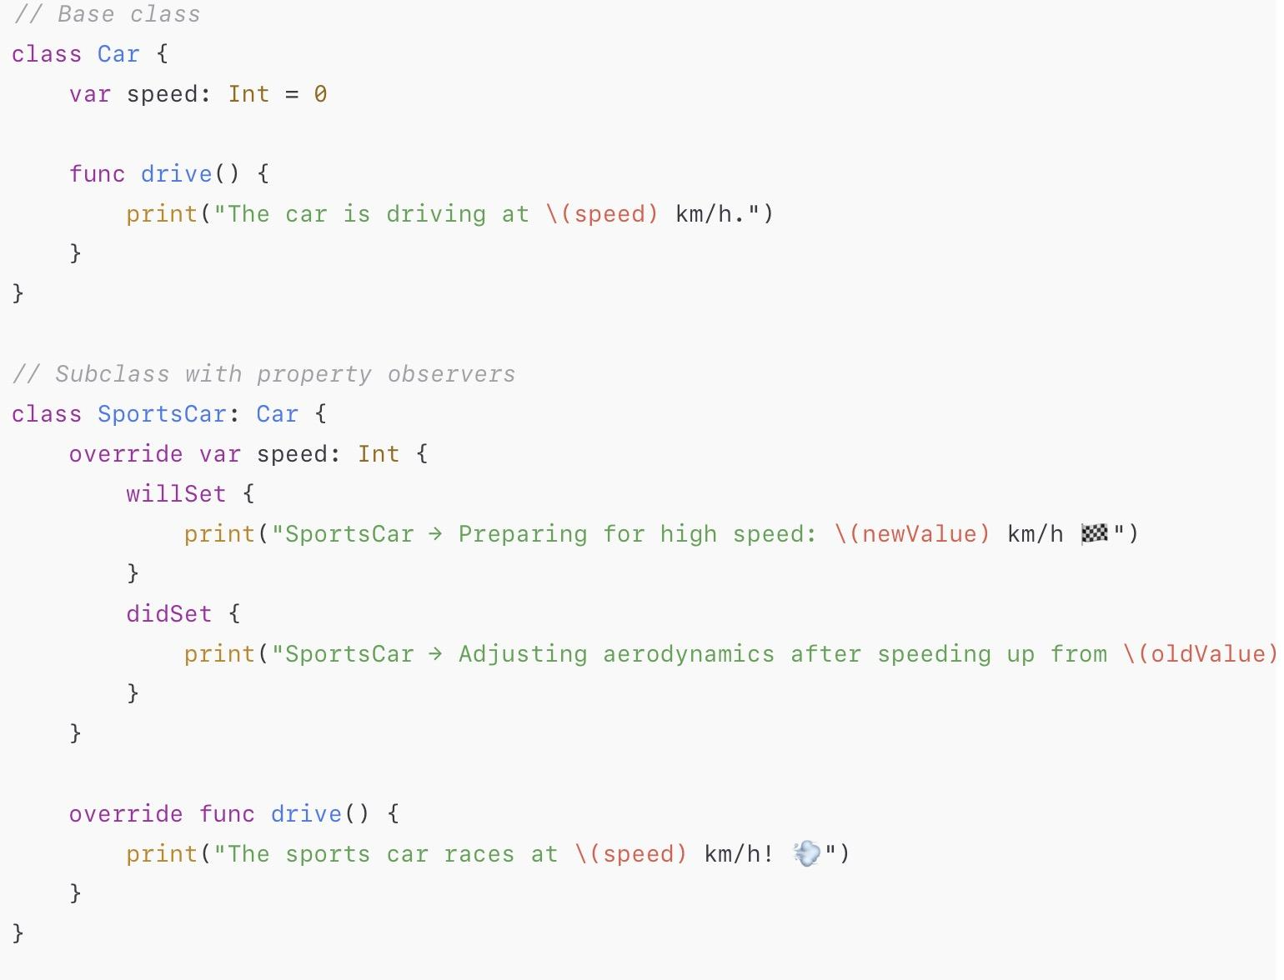
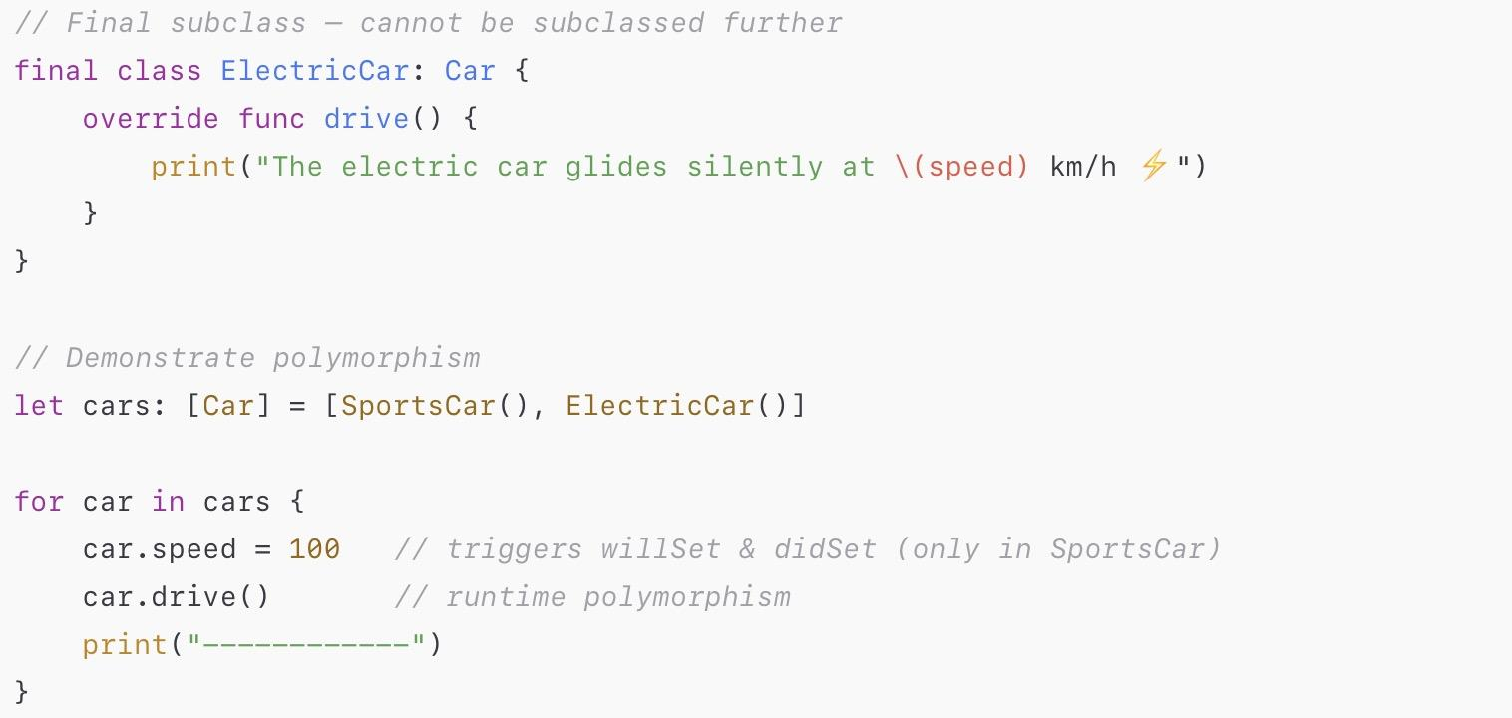
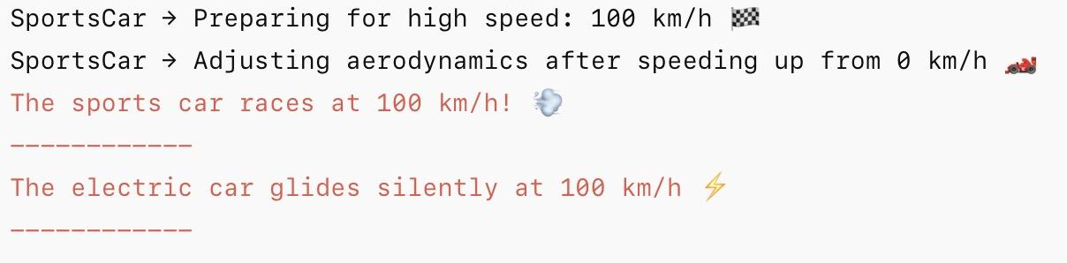
Polymorphism
Polymorphism in Swift is the ability of objects of different classes to be treated as if they have the same type.
Runtime polymorphism : achieved by inheritance and method overriding.
Override: Redefines an inherited method, property, or subscript.
Swift ensures override correctness by checking that each override matches a superclass definition.
Subclasses can add property observers (willSet, didSet) to inherited properties—whether stored or computed.
Final: used to stop overriding, A final class cannot be subclassed at all.
Source : Closures

Slide 24
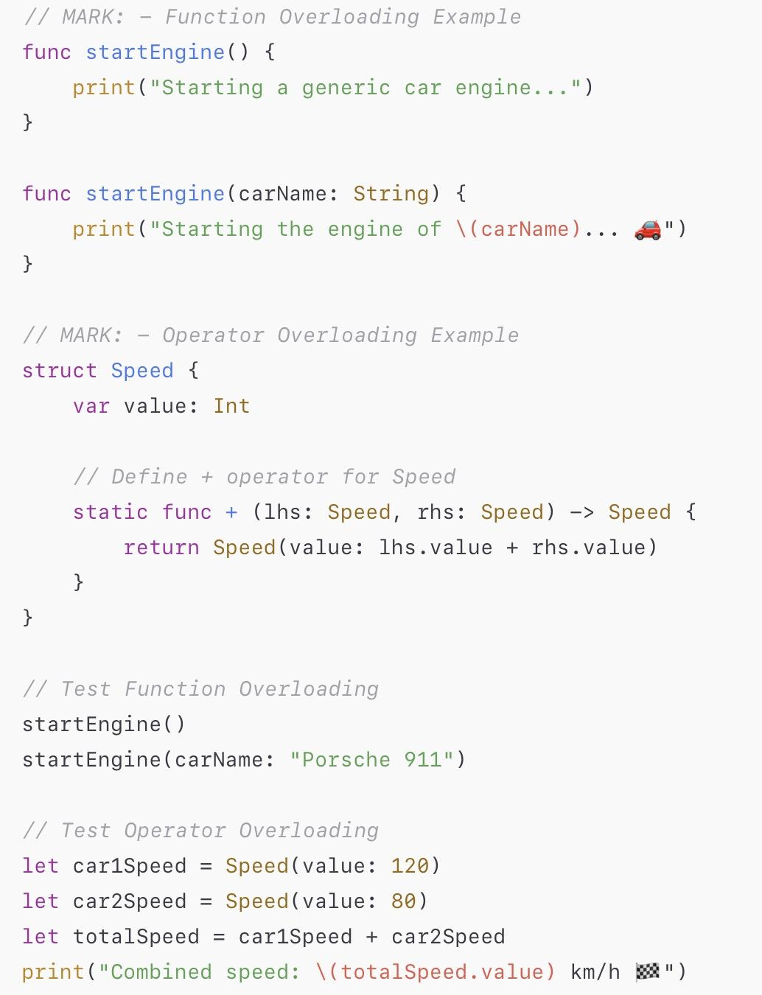
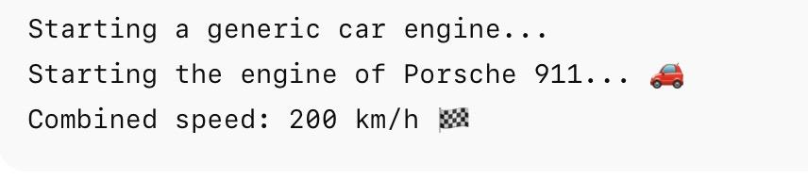
Compile-time polymorphism
Compile-time polymorphism is achieved through function overloading, which allows you to define multiple functions with the same name but with different parameter types.
Function Overloading:
Define multiple functions with the same name but different parameter types or counts.
The Swift compiler determines which function to call at compile time.
Operator Overloading
Gives custom meaning to operators (+, -, *, /, <, >, etc.)
Implemented as static methods inside a struct or class.
Source : Closures

Slide 25
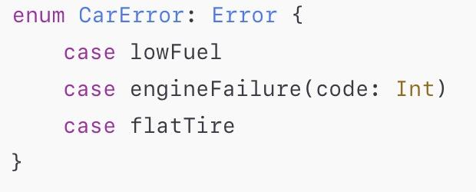

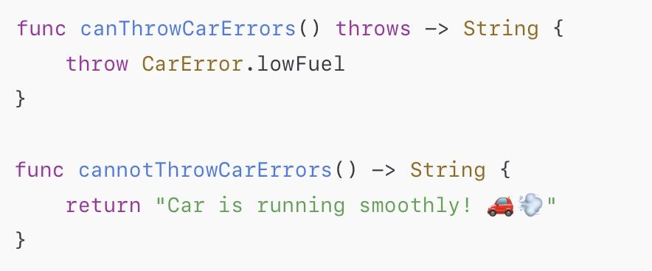
Error protocol: defines error types.
Exception Handling and Event Handling
Error handling allows programs to respond to runtime failures.
Instead of crashing, the program can catch and handle errors safely.
Swift provides keywords using “throw”, “throws”, and “do-catch”.
Throwing an error lets you indicate that something unexpected happened and the normal flow of execution can’t continue.
Throw tells Swift: “❗Something went wrong — stop here and find someone to handle the error!”
throw : used to throw an error.
throws : marks a function that can throw an error.
do–catch : used to handle thrown errors by running a block of code.
Try : used when calling a function that can throw an error.
Defer : lets you schedule code to run just before the current scope exits —no matter how it exits (normal return, error thrown, or early break).
Error handling in Swift is safe, efficient, and type-checked at compile time.
Propagate the Error (using throws)
Only throwing functions can propagate errors. Any errors thrown inside a nonthrowing function must be handled inside the function.
Source : Closures

Slide 26
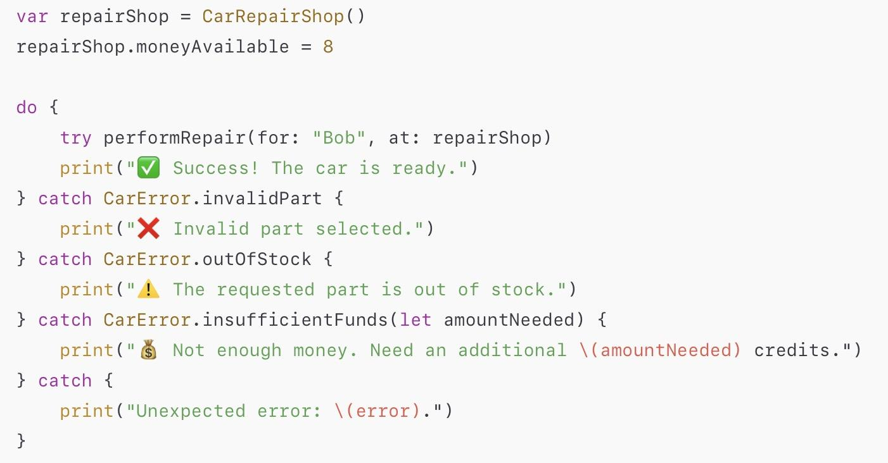
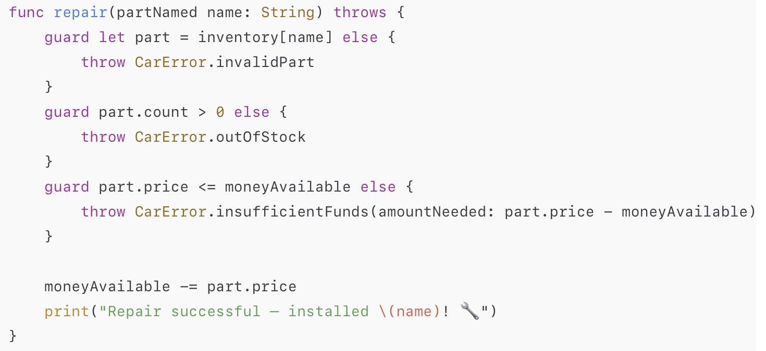
Exception Handling and Event Handling
If a try expression inside the do block “throws an error”, Swift immediately jumps out of the do block and looks for a matching catch.
If no error is thrown, the do block finishes normally and the catch blocks are skipped.
Source : Closures

Slide 27
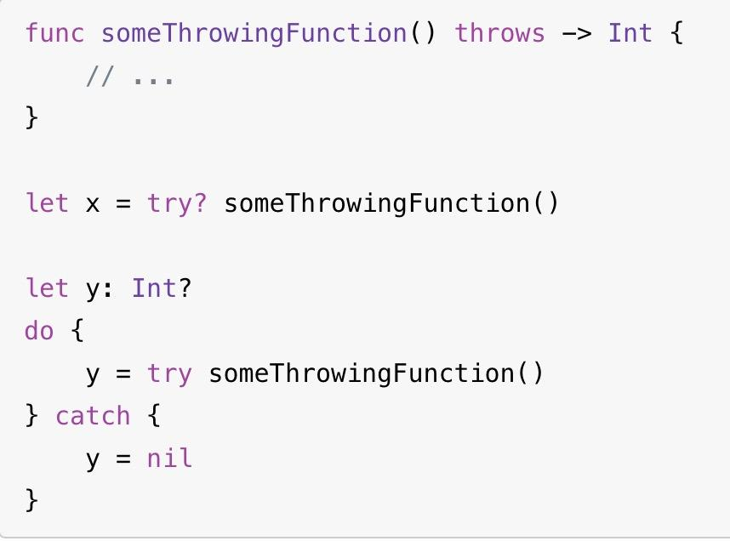
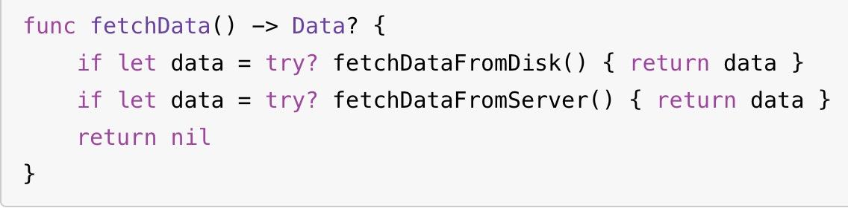
Exception Handling and Event Handling
“Try?” : converts a thrown error into an optional value (nil if failed).
“Try!” : forces execution, used to disable error propagation; crashes if an error occurs.
If an error occurs, then x and y = nil. If no error, then they contain the function’s result.
Try! is perfect when you only care whether something succeeded or failed, not why it failed.
Asserts that no error will occur at runtime.
Use only when failure is impossible (e.g. load resources).
If file missing, then runtime error occurs.
Source : Closures

Slide 28
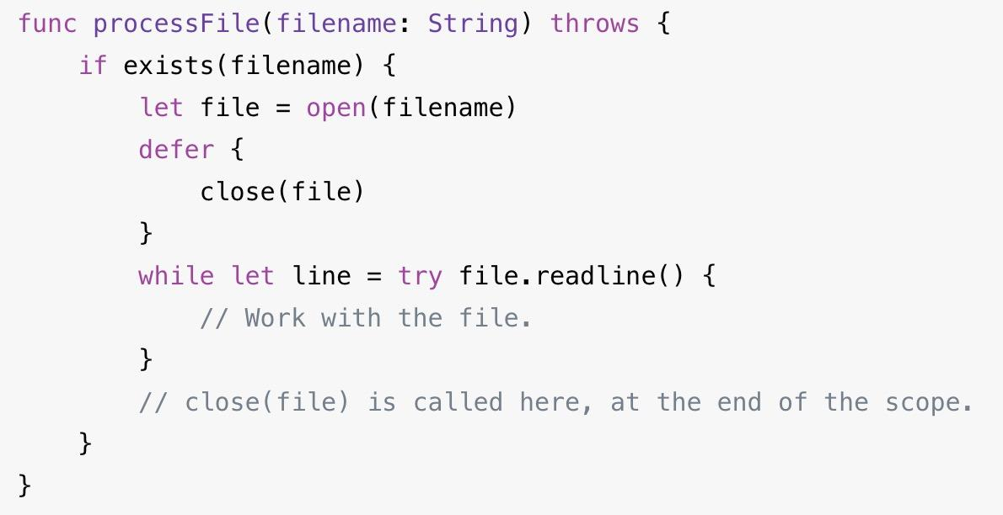
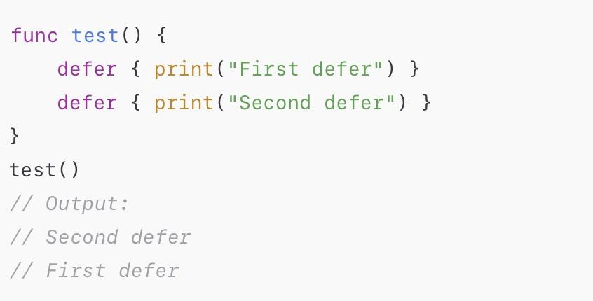
Exception Handling and Event Handling
Defer ensures certain code always runs when leaving a scope, no matter how the scope exits:
Normally (end of function/block)
Early exit with return
error is thrown
It’s mainly used for cleanup actions like:
Closing files
Releasing resources
Freeing memory
Defer in Swift follows last in first out order (LIFO) just like stack.
Source : Closures

Slide 29
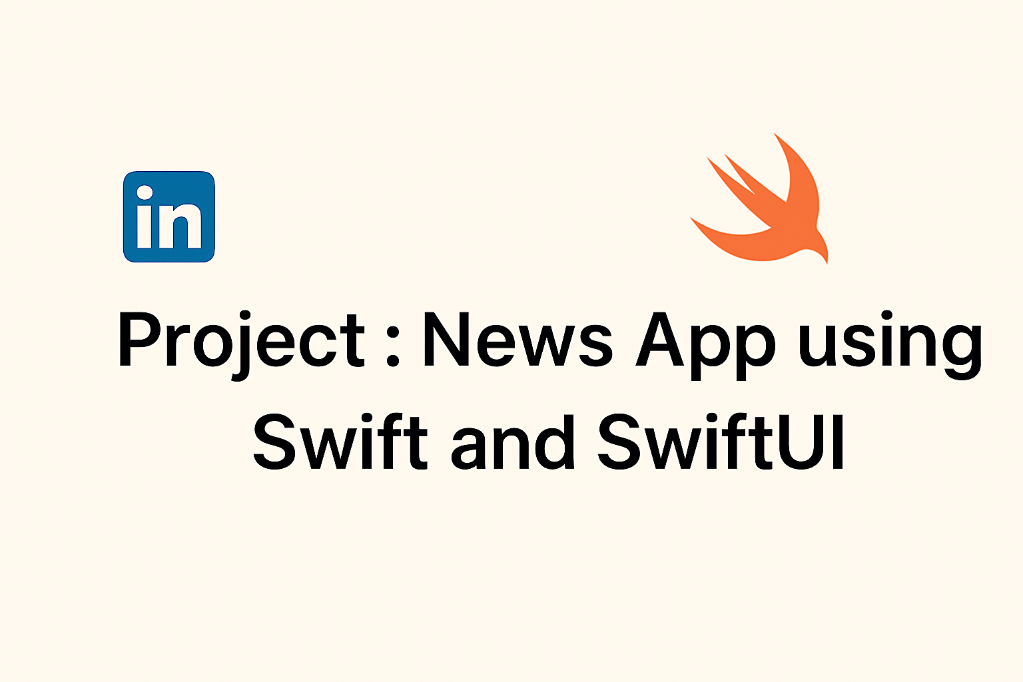
Exception Handling and Event Handling
Project :
Source : Closures

Slide 30

Objectives of the Project :
To develop a modern iOS News App that displays real-time news using Swift and SwiftUI.
To explore and utilize Swift’s latest @Model and @Query macros for managing app data declaratively.
To provide users with a simple and interactive experience for browsing, bookmarking, and reading news.
To integrate watchOS support for quick access to headlines and updates on Apple Watch.
Exception Handling and Event Handling
Project :
Source : Closures

Slide 31

Features :
The app has several main features:
Fetch news based on categories: general, business, science, technology, health, entertainment, sports
Bookmark articles so it can be persisted even when the app restarts.
Share article using native iOS share sheet UIActivityController.
Read article inside a Safari Webview in modal sheet presentation.
Search news based on the search query you type on the search bar.
Recent search history list.
Suggestion search list.
Watch Connectivity and Watch Face Complication support for watchOS.
Intent Configurable Widgets - iOS, iPadOS, macOS - S, M, L, XL Family Sizes
Exception Handling and Event Handling
Project :
Source : Closures

Slide 32
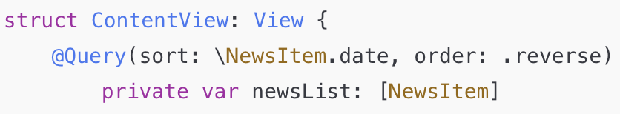
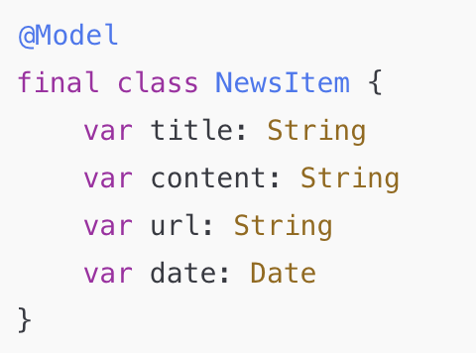

Class-based model definition declared with the @Model macro
Supports Swift primitive types: String, Int, Double, Bool, Date, UUID
Libraries: SwiftData, SwiftUI
Macros: @Model to Convert a class into a persisted model. @Query to Retrieve data as model instances
SwiftData: Declaratively define models with built-in SQL persistence and efficient data fetching.
Exception Handling and Event Handling
Project :
Fetch model instances in view
Define
Register the data container in main function
This setup the database for us in app.
It tells swiftData to create a place to store and manage all NewsItems date like saving, loading or updating our News articles.
Source : Closures

Slide 33
Generate topics by extracting and ranking terms from text using NLTagger’s syntactic and semantic analysis and NLEmbedding’s vector-based semantic similarity. Then classifying the news with this topics.
Libraries:
NLTagger: used for part-of-speech tagging and lemmatization.
NLEmbedding: provides pre-trained semantic word vectors and cosine-similarity scoring.
Foundation: text cleaning, token splitting, and basic data structures.
Core ML: backend support for NLEmbedding models.
Content-based Topic Generate: Using natural language libraries in swift to process news content and generate topics
Exception Handling and Event Handling
Project :
Normalize & Weight
Clean text using foundation
Remove spaces and common words Give useful Info
Tag & Filter (NLTagger)
Find word type Keep Imp Words
Merge Phrases & Lemmatize
Combine related words
Change words to base
Vectorize & Score (NLEmbedding)
Change word into numbers
Give words a score
Rank → Top-5 Keywords
Rank words by scores Pick top 5 keyword
Source : Closures

Slide 34

Constraints :
1. Platform Limitation
Built using SwiftUI, works only on Apple devices: iOS, iPadOS, macOS, watchOS, tvOS.
Relies on Apple frameworks like UIKit, AppKit, and Combine, which are not available on Android or Windows.
2. API & Content
Requires a NewsAPI.org key, subject to rate limits and terms of service.
Only supports HTTPS connections, scraping websites without permission is not allowed.
3. Data & Storage
Runs in an app sandbox with limited local storage (cache, UserDefaults, CoreData).
Images and large content need efficient caching, pagination, and lazy loading.
4. Privacy & Policy
Analytics or tracking features require a Privacy Policy and ATT compliance.
Widgets have strict size and data freshness limits.
Exception Handling and Event Handling
Project :
Source : Closures

Slide 35

Technologies Used :
Swift – Core programming language used to develop the app.
SwiftUI – Framework for building responsive and declarative user interfaces.
Foundation Library – Provides essential tools for handling strings, dates, files, URLs, and JSON.
Xcode – Integrated Development Environment (IDE) for coding, testing, and debugging.
iOS Simulator – Allows testing and previewing the app on MacBook, simulating devices like iPhone 16.
NewsAPI.org – External API used to fetch live news data.
SafariServices (SFSafariViewController) – Opens and displays news articles within the app.
WatchConnectivity Framework – Enables communication between iPhone and Apple Watch.
Exception Handling and Event Handling
Project :
Source : Closures

Slide 36

Where This Project Can Be Applied :
Personal News Reader App – For users who want a customized and ad-free news reading experience on Apple devices.
Educational Projects – Ideal for students and developers to learn Swift, SwiftUI, and API integration.
Corporate or Institutional News Apps – Can be adapted for internal company updates or university announcements.
WatchOS Companion App – Quick access to top headlines and notifications on Apple Watch.
Prototype for Media Companies – Can serve as a base model for professional news or magazine apps.
Exception Handling and Event Handling
Project :
Source : Closures

Slide 37
Exception Handling and Event Handling
Works Cited Page
Project :
Swift Documentation — Swift.org https://www.swift.org/documentation/
Apple Inc. Swift Developer Documentation. https://developer.apple.com/documentation/Swift
Swift — Medium Articles https://medium.com/tag/swift
GeeksforGeeks. “Swift Tutorial.” https://www.geeksforgeeks.org/swift/swift-tutorial/
Source : Closures

Slide 38
Exception Handling and Event Handling
Project :
Thank you for your watching !!!!!!!
Source : Closures

Slide 39
PPT CODES : 1) NAMES – let carBrand = "Tesla" var carSpeed = 120 func showCarInfo() { print("The \(carBrand) is moving at \(carSpeed) km/h!") } 2) Binding – let fuelEfficiency = 15.0 // constant binding (km per liter)
var fuelLevel = 50.0
class Vehicle {
func sound() { print("Engine sound") }
}
class Car: Vehicle {
override func sound() { print("The car is running smoothly") }
}
let myVehicle: Vehicle = Car()
myVehicle.sound() // Runtime binding → "The car is running smoothly"

Slide 40
3) Scopes let carBrand = "Tesla" // global variable
func showCarInfo() {
let carModel = "Model S" // local variable
print(carBrand) // ✅
}
4) Topic Scopes - Example closue func addMileage(by distance: Int) -> () -> Int {
var totalMileage = 0
return {
totalMileage += distance
return totalMileage
}
}
let drive10km = addMileage(by: 10)
print(drive10km()) // 10
print(drive10km()) // 20

Slide 41
5) Data Types // Int
var carSpeed: Int = 120
print(carSpeed) // Output: 120
// Double
let fuelCapacity: Double = 45.5
print(fuelCapacity) // Output: 45.5
// Float
let tirePressure: Float = 32.8
print(tirePressure) // Output: 32.8
// Bool
let engineOn: Bool = true
print(engineOn) // Output: true

Slide 42
6) Data Types // String
let name: String = "Hardhiq"
print(name) // Output: Hardhiq
// Character
let letter: Character = "A"
print(letter) // Output: A
// Array
var numbers: [Int] = [1, 2, 3]
print(numbers) // Output: [1, 2, 3]
// Dictionary
var capitals: [String: String] = ["US": "Washington", "UK": "London"]
print(capitals) // Output: ["US": "Washington", "UK": "London"]
// Optional
var middleName: String? = nil
middleName = "James"
print(middleName!) // Output: James

Slide 43
7) Functional Programming (Pure Function) func speedSquared(_ speed: Int) -> Int {
return speed * speed
}
print(speedSquared(10)) // Output: 100
print(speedSquared(10)) // Output: 100 (same input → same output)

Slide 44
9) Topic Functional Programmig (Immutable data) let maxSpeed = 200
// maxSpeed = 180 // ❌ Error: Cannot assign to a let constant 10) Topic Functional Programming (Higher-order Functions) func applyTwice(_ f: (Int) -> Int, _ value: Int) -> Int {
return f(f(value))
}
func increaseSpeed(_ speed: Int) -> Int { speed + 10 }
print(applyTwice(increaseSpeed, 50)) // Output: 70

Slide 45
11) Topic ( Functional Programming) (Map, Filter, Reduce) let speeds = [60, 80, 100, 120, 140] // speeds in km/h
// Map → double each speed (e.g., hypothetical racing mode)
let doubledSpeeds = speeds.map { $0 * 2 }
print(doubledSpeeds) // Output: [120, 160, 200, 240, 280]
// Filter → only even speeds
let evenSpeeds = speeds.filter { $0 % 2 == 0 }
print(evenSpeeds) // Output: [60, 80, 100, 120, 140]
// Reduce → total speed sum (just as an example)
let totalSpeed = speeds.reduce(0) { $0 + $1 }
print(totalSpeed) // Output: 500 12) Topic ( Functional Programming) (Closure) func makeSpeedMultiplier(by factor: Int) -> (Int) -> Int {
return { speed in speed * factor }
}
let turboMode = makeSpeedMultiplier(by: 3)
print(turboMode(50)) // Output: 150

Slide 46
13) Concurrency listCars(inGarage: "Sports Collection") { carNames in
let sortedCars = carNames.sorted()
let firstCar = sortedCars[0]
downloadCarDetails(named: firstCar) { car in
show(car)
}
} 14) Concurrency let carNames = await listCars(inGarage: "Luxury Collection")
let sortedNames = carNames.sorted()
let name = sortedNames[0]
let car = await downloadCarDetails(named: name)
show(car) 15) Topic Concurrency ( Asynchronous Functions) func listCars(inGarage name: String) async throws -> [String] {
try await Task.sleep(for: .seconds(2)) return ["CAR001", "CAR99", "CAR0404"]
}
let cars = try await listCars(inGarage: "Downtown Showroom")

Slide 47
16) Concurrency (Asynchronous Sequences) import Foundation
let carDataHandle = FileHandle.standardInput
for try await carInfo in carDataHandle.bytes.lines {
print("Processing car info: \(carInfo)") } 17) Concurrency (Parallel Asynchronous Calls) let firstCar = await downloadCarDetails(named: carNames[0])
let secondCar = await downloadCarDetails(named: carNames[1])
let thirdCar = await downloadCarDetails(named: carNames[2])
let cars = [firstCar, secondCar, thirdCar]
show(cars)
// Output: All cars printed in ~6s (2s per car) 18) Concurrency ( Parallel Asynchronous Calls) async let firstCar = downloadCarDetails(named: carNames[0])
async let secondCar = downloadCarDetails(named: carNames[1])
async let thirdCar = downloadCarDetails(named: carNames[2])
let cars = await [firstCar, secondCar, thirdCar]
show(cars)
// Output: All cars printed in ~2s (all downloaded concurrently)

Slide 48
19) Topic Concurrency (Task and Task Group) await withTaskGroup(of: Car.self) { group in
let carNames = await listCars(inGarage: "Luxury Collection")
for name in carNames {
group.addTask {
return await downloadCarDetails(named: name)
}
}
for await car in group {
show(car)
}
}
// Output:
// Downloads all car details concurrently (like multiple car info fetching at once)
// Each car is shown as soon as its data is ready
// Total time ≈ time of the slowest car download (not sum of all) 20) Topic Concurency (Unstructured Concurrency) let newCar = // ... some car data ...
let handle = Task {
return await add(newCar, toGarageNamed: "City Collection")
}
let result = await handle.value
// Output: Adds a new car to "City Collection" asynchronously,
// waits for the result, then stores it in `result`.

